Slide 1
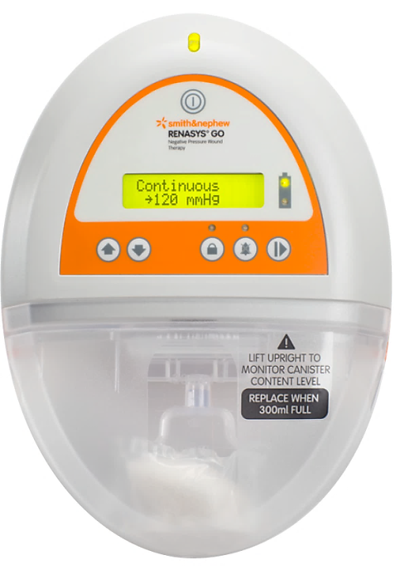
RENASYS™ GO NPWT Product training
Indications, contraindications, warnings, precautions
Product overview
Functionality
Alarms function, cause and remedy
Leak/blockage alarm cautions
Bridging cautions and considerations
Accessories
Ordering information
Notes:
The RENASYS™ GO device is designed to provide Negative Pressure Wound Therapy to a closed environment over a wound, in order to evacuate exudates from the wound site to
a disposable container, which may promote wound healing via removal of fluids, including irrigation and body fluids, wound exudates and infectious materials.
Todays presentation will cover the following agenda (Next slide)

Slide 2
Indications for use:
RENASYS™ GO is indicated for patients who would benefit from a suction device (Negative Pressure Wound Therapy), as it may promote wound healing via removal of fluids, including irrigation and body fluids, wound exudates and infectious materials.
Appropriate wound types include:
Chronic
Acute
Traumatic
Sub-Acute and dehisced wounds
Ulcers (such as pressure or diabetic)
Partial-thickness burns
Flaps and grafts
NOTE: Full device operation is found in the Clinician User Manual for the RENASYS GO device
2
Notes:
Speaker notes/guidance:

Slide 3
Contraindications
The use of the RENASYS™ GO System is contraindicated in the presence of:
Necrotic tissue with eschar
Untreated osteomyelitis
Malignancy in wound (with exception of palliative care to enhance quality of life)
Exposed arteries, veins, organs or nerves
Non-enteric and unexplored fistulas
Anastomotic sites
NOTE: Full device operation is found in the User Manual for the RENASYS GO device
3
Notes:
Speaker notes/guidance:

Slide 4
Warnings
1. Carefully monitor patients for signs of bleeding, which may lead to interruption in therapy and hemodynamic instability. If such symptoms are observed, immediately discontinue therapy, take appropriate measures to control bleeding, and contact treating clinician
2. Patients suffering from difficult hemostasis or who are receiving anticoagulant therapy have an increased risk of bleeding. During therapy, avoid using hemostatic products that, if disrupted, may increase the risk of bleeding
3. Do not use directly on exposed blood vessels or organs. Sharp edges such as bone fragments must be covered or removed prior to initiating therapy, due to risk of puncturing organs or blood vessels drawn closer under the action of negative pressure
4. NPWT has not been studied on pediatric patients. Patient size and weight should be considered when prescribing the device
5. Foam or gauze must not be tightly packed or forced into any wound area. Over-packing may interfere with distribution of NPWT evenly across the wound. This may decrease the ability of the wound to properly contract and permit exudate to remain in wound
6 In the event defibrillation is required, disconnect device from wound dressing prior to defibrillation. Remove wound dressing only if its location will interfere with defibrillation
7. Device is not MRI compatible. Do not bring device into MRI suite. Prior to entering MRI suite, disconnect device from dressing. Dressing can remain intact on patient
8. Do not use the device in oxygen enriched environment or in areas where there is danger of explosion (eg, hyperbaric oxygen unit)
9. When operating, transporting or disposing of device and accessories, there is risk of infectious liquids being aspirated or contamination of device assembly through incorrect use. Universal precautions should be observed whenever working with potentially contaminated components or equipment
10. Device and canister kits are provided non-sterile and should not be placed within a sterile field
NOTE: Full device operation is found in the User Manual for the RENASYS◊ GO Device
4
Notes:
Speaker notes/guidance:

Slide 5
Precautions
1. More frequent device and wound dressing monitoring, should be taken for patients who are or may be:
Suffering from infected blood vessels
Receiving anticoagulant therapy or platelet aggregation inhibitors, in addition to patients with intrinsic coagulation problems such as low platelet counts
Actively bleeding or have friable blood vessels or organs
Suffering from abnormal wound hemostasis
Untreated for malnutrition
Noncompliant or combative
Suffering from wounds in close proximity to blood vessels or friable fascia
When monitoring patients for delivery of therapy, ensure wound dressing is free of air leaks, fully compressed and firm to the touch
NOTE: Full device operation is found in the User Manual for the RENASYS◊ GO Device
5
Notes:
Speaker notes/guidance:

Slide 6
Precautions continued
2. As a condition of use, device should only be used by qualified and authorized personnel. User must have necessary knowledge of the specific medical application for which NPWT is being used
3. For patients with high risk of bleeding, use 300mL canister. Ensure the 300mL canister viewing is checked frequently for signs of bleeding
4. The dressing seal may be lost or pooling may occur, without alarm activation, when an occlusion forms on the wound side of the dressing. Viscous, purulent or serosanguineous drainage may contribute to occlusion of the dressing. Regular monitoring of device and dressing is required to ensure full delivery of therapy and exudate removal. Ensure the wound dressing is free of air leaks, fully compressed and firm to the touch whenever therapy is active
5. Underlying structures, such as bone, tendons, ligaments and nerves should be covered with natural tissue or a non-adherent dressing layer prior to applying the NPWT dressing to ensure protection and minimize the risk of damage from direct contact with the dressing
6. To minimize the risk of bradycardia, do not place NPWT in proximity to the vagus nerve
7. In the event a patient with spinal cord injury experiences autonomic dysreflexia, discontinue use of NPWT and immediately seek medical assistance
8. When treating enteric fistulas, do not place NPWT dressing in direct contact with exposed bowel. Cover the wound bed, including fistula opening, with non-adherent gauze or with one layer of saline moistened gauze. During the course of treatment patient’s fluid levels must be closely monitored
NOTE: Full device operation is found in the User Manual for the RENASYS◊ GO Device
6
Notes:
Speaker notes/guidance:

Slide 7
Precautions continued
9. Avoid use of circumferential dressings except in cases of edema or heavily exuding extremities, where this technique may be necessary to maintain a seal. Consider using multiple drapes to minimize risk of decreased distal circulation. Regularly assess distal pulses, and discontinue therapy if changes in circulation are detected
10. Monitor patient for any signs of local or systemic infection. Infected wounds may require more frequent dressing changes. If there are any signs of systemic infection or advancing infection at wound area, contact treating clinician immediately
11. If multiple pieces of foam or gauze are needed to fill the wound profile, count and record how many pieces are present to ensure all pieces are removed at a dressing change to minimize the risk of retention and possible infection
12. NPWT should remain on for duration of treatment. The length of time a patient may be disconnected from device is a clinical decision based on individual characteristics of patient and wound. Factors to consider include location of wound, volume of drainage, integrity of dressing seal, assessment of bacterial burden and patient’s risk of infection
13. Do not use a dressing kit with breached or damaged packaging
14. Use of NPWT presents a risk of tissue ingrowth. Tissue ingrowth may be reduced by reducing therapy pressure, using a wound contact layer or increasing the frequency of dressing changes
15. NPWT should not be painful. If patient reports discomfort, consider reducing pressure setting and use of a wound contact layer. Pressure setting is a clinical decision based on individual characteristics of patient and wound. Factors to consider include location of wound, volume of drainage and integrity of dressing seal
NOTE: Full device operation is found in the User Manual for the RENASYS◊ GO Device
7
Notes:
Speaker notes/guidance:

Slide 8
Precautions continued
16. Maintain regular monitoring of device and wound site during therapy to ensure therapeutic treatment and patient comfort
17. Device is only to be used with Smith & Nephew authorized components. Use of any other products have not been proven safe and effective with RENASYS™ GO device
18. Ensure canister tubing and RENASYS Soft Port are installed completely and without any kinks to avoid leaks or blockages in vacuum circuit. Position device and tubing appropriately to avoid risk of a trip hazard. Device and system tubing should be positioned in a more prominent location, no more than 19in or 50cm higher than the wound to ensure optimization of therapy and prevent therapy interruption
19. When bathing or showering patient must disconnect from device, protecting both ends of RENASYS Soft Port tubing using tethered caps. Ensure aeration disc located near Quick Cick connector is free of moisture before reactivation of therapy to ensure proper alarm functionality and prevent interruption in therapy
20. If any liquids penetrate device, discontinue use and return to your Smith & Nephew authorized provider for service
21. CT scans and x-ray have the potential to interfere with some electronic medical devices. Keep device out of x-ray or scanner range
22. Do not use in the presence of a flammable anesthetic mixture with air or with oxygen or nitrous oxide
23. Electrical mains power can only be removed by disconnecting power cord or AC power adaptor. Take care in positioning the device to allow access to cord receptacle
NOTE: Full device operation is found in the User Manual for the RENASYS◊ GO Device
8
Notes:
Speaker notes/guidance:

Slide 9
Precautions continued
24. If power cord is damaged, wires are frayed or exposed, do not use power cord. Contact your Smith & Nephew representative for a replacement cord
25. Canisters should be changed at least once a week, whenever there is a change in patient or in the event that canister contents reach maximum volume indication (300mL or 750mL fill line)
Do not wait for the canister over-capacity alarm to activate to change canister
26. Canisters kits are single use devices. Do not reuse
27. Do not apply SECURA™ No-Sting SKIN-PREP barrier film wipes directly to open wounds. SECURA No-sting barrier film is flammable. Use in a well ventilated area. Avoid using around flames and sources of ignition Keep out of reach of children. For external use only
28. As with all adhesive products, apply and remove dressing carefully from sensitive or fragile skin to avoid blistering and skin stripping, especially after frequent dressing changes. Use of skin sealant may assist with protection of periwound skin
29. If patient must be disconnected, the ends of the RENASYS™ Soft Port and canister tubing should be protected using tethered caps to avoid leakage of fluid and cross contamination
NOTE: Full device operation is found in the User Manual for the RENASYS GO Device
9
Notes:
Speaker notes/guidance:

Slide 10
Physician orders
Prior to placement of RENASYS™ GO, Device the medical professional treating the wound must assess how to best use the system for an individual wound.
It is important to carefully assess wound and patient to ensure clinical indications for Negative Pressure Wound Therapy (NPWT) are met.
All orders should include:
Wound location, size and type
Smith & Nephew wound dressing kit
Pressure settings
Frequency of dressing changes
Adjunctive dressings
NOTE: Full device operation is found in the User Manual for the RENASYS GO Device
10
Notes:
Speaker notes/guidance:

Slide 11
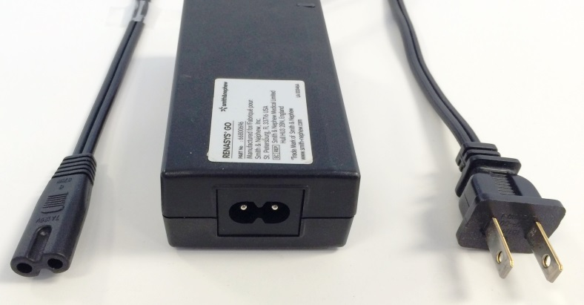
RENASYS™ GO device model
RENASYS GO 66021496
Intended for use in acute care and home healthcare settings, use is conducted by or under the supervision of a qualified healthcare provider
This model has been updated to meet IEC 60601-1 3rd Edition compliance standards for facility use
The RENASYS GO device is designed to be used with Smith & Nephew Class II power supply REF 66801558
The RENASYS GO can be used in commercial aircraft and any other transportation environments.
Notes:
The RENASYS◊ GO is a portable Negative Pressure Wound Therapy (NPWT) device. The RENASYS GO Device is designed to be used with Smith & Nephew Class II power supply REF 66801558 in home healthcare and Acute Care settings. For proper and effective use of the RENASYS GO device, use only RENASYS GO canisters, RENASYS Dressing kits and RENASYS ancillary componentry. Refer to instructions for use provided with dressing kits for additional information on dressing use and maintenance.
To ensure that the home healthcare device is safe for use in residential settings, this device is compliant with the IEC medical equipment and medical electrical safety standard 60601-1-11 for use of medical devices in the home healthcare environment. This standard includes the use of a double insulated Class II power supply and Class II power cord.
The RENASYS GO can be used in commercial aircraft and any other transportation environments.

Slide 12
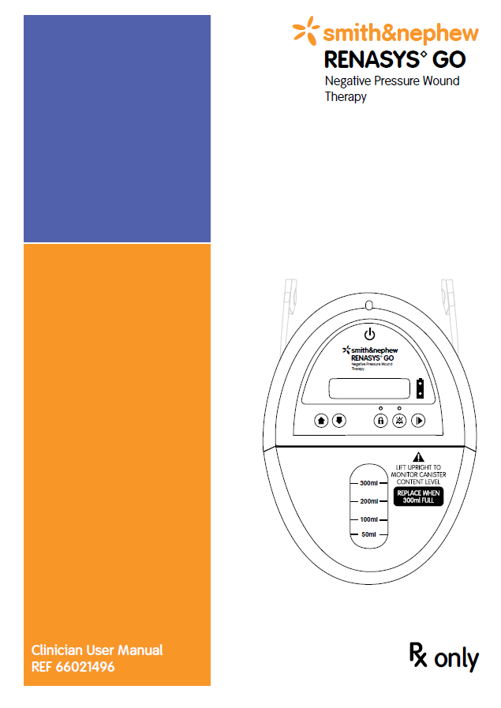
RENASYS™ GO device
Users should refer to the Clinician User Manual for important information regarding the safe and effective operation of the device and troubleshooting
The user manual contains detailed information including indications for use, contraindications, precautions and warnings
Notes:
This user manual contains important information regarding the safe and effective operation of the RENASYS GO (REF 66021496) Negative Pressure Wound Therapy (NPWT) system. This device is intended for use by or on the direction of a trained and licensed physician in both professional healthcare facilities and in residential settings including nursing homes. This manual is intended to aid in the training of personnel and to provide a reference for experienced users.

Slide 13
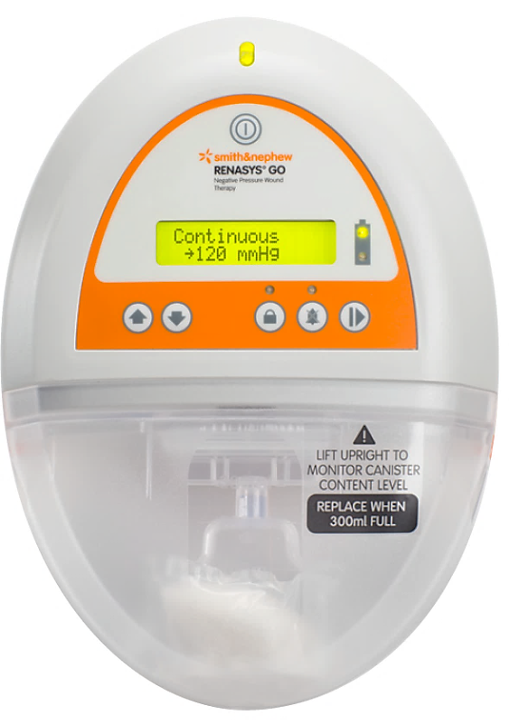
RENASYS™ GO overview
Vacuum: -40 to -200 mmHg
The device adjustments can be made in 10mmHg increments between 40mmHg and 100mmHg
20mmHg increments between 100mmHg and 200mmHg
Dimensions: 175mm x 210mm x 85mm
Weight: 2.4 lb (1.1kg)
Battery operation: Up to 20 hours
Battery operations: Lithium ion rechargeable
Charging time: Approx. 3 hours for 80% capacity
Canisters: 300mL and 750mL

Slide 14
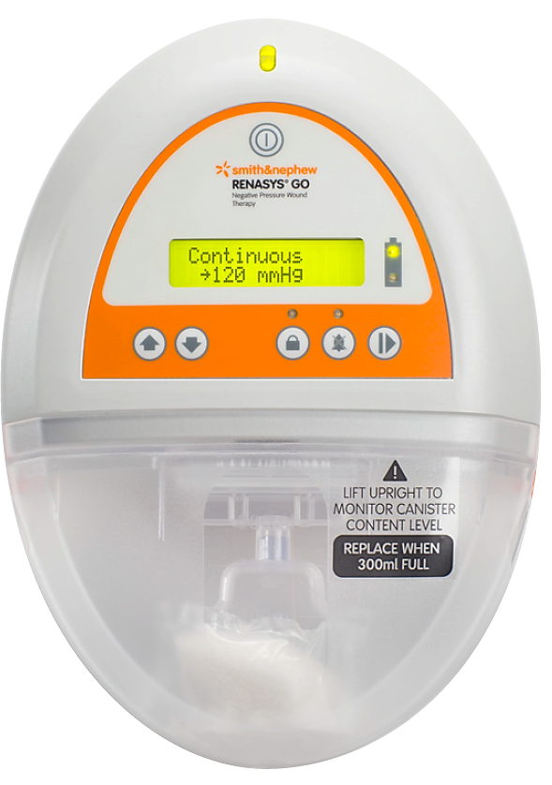
RENASYS™ GO user interface
Front view
Status/alarm indicator
Power button
Display screen
Battery status indicator
Up and down selectors
Start/pause therapy and select
Audio pause
Keypad lock
Fill warning label
Canister

Slide 15
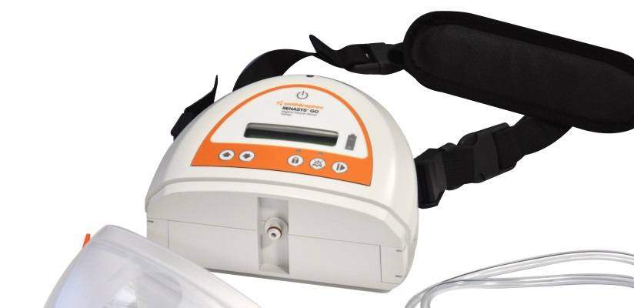
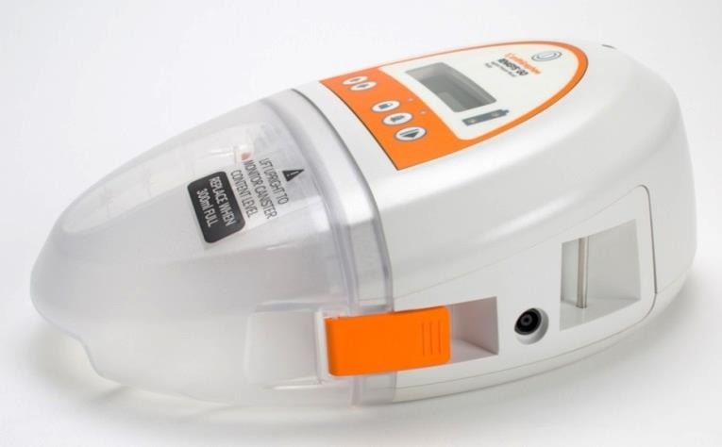
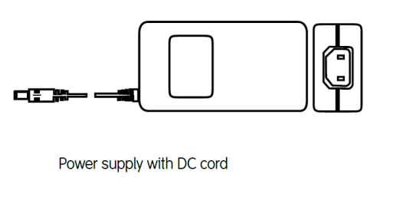
Shoulder Strap
Side View
Inlet connector and “O” ring
Canister clips
Electrical power inlet

Slide 16
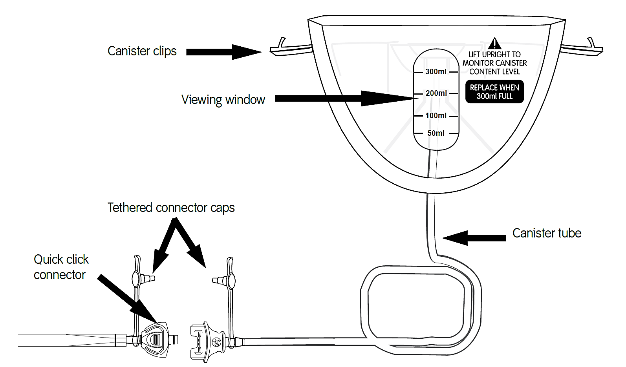
RENASYS GO™ Canisters 300mL and 750mL
300mL shown

Slide 17
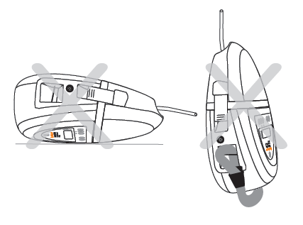
RENASYS™ GO orientation
Recommended orientation
Incorrect
orientation
Notes:
RENASYS GO device may also be used in a horizontal orientation, with device facing upward. However, to maximize canister volume and optimize canister over-capacity alarm, upright device orientation is recommended.

Slide 18
RENASYS™ GO orientation
RENASYS GO may also be used in a horizontal orientation, with the device facing upward. However, to maximize canister volume and optimize canister over-capacity alarm, upright device orientation is recommended
Caution: When device is operating in horizontal orientation, facing upward, alarm functionality may be compromised. Monitor wound dressing to ensure it is fully compressed and firm to the touch.

Slide 19
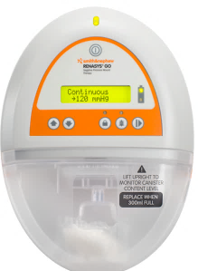
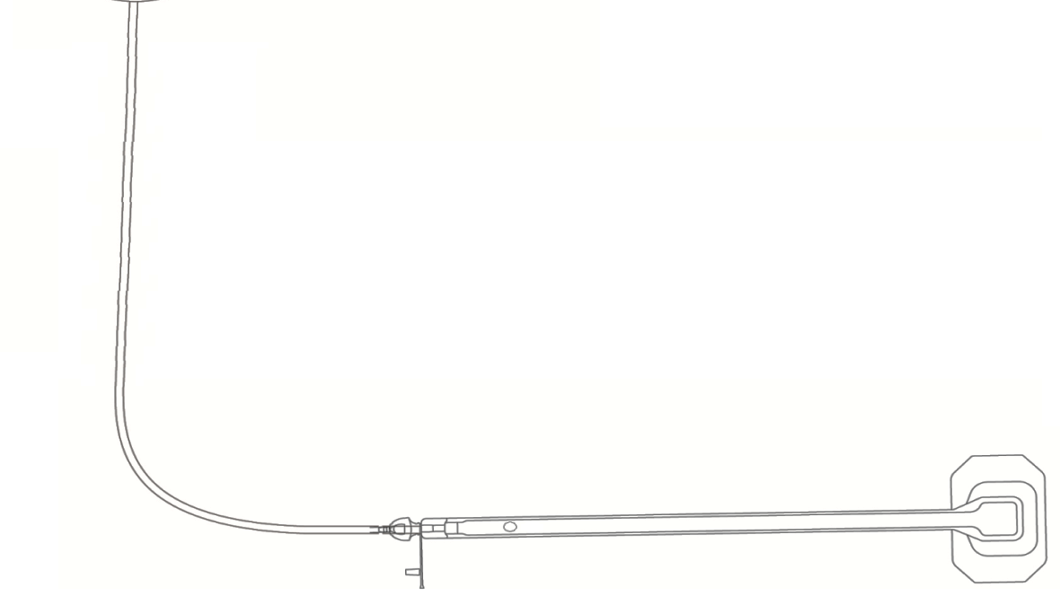
Device/tubing height relative to the wound
RENASYS™ GO should not be placed greater than 19in (50cm) above the wound
< 19in (50cm)
Ensures that the appropriate vacuum (pressure) is transmitted to the wound site
Notes:
NOTE: Positioning the RENASYS GO at the wound level and reasonable distances below the wound level is fine. Ensuring the device is not positioned greater than 19 in (50cm) above the wound is because the weight of fluid in a long vertical run of vertical tube may reduce the effective vacuum at the wound.

Slide 20
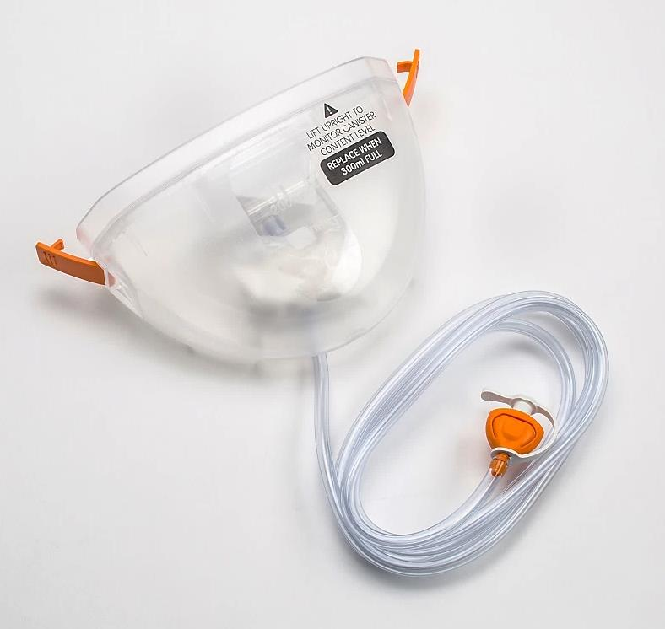
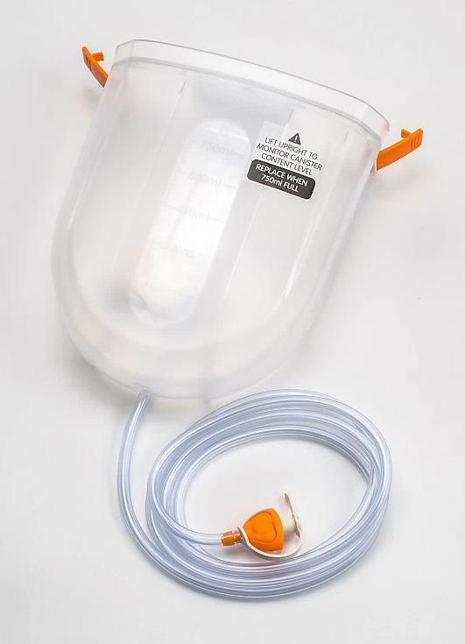
RENASYS™ GO canister selection and installation
RENASYS GO is designed to be used with the RENASYS GO 300mL or 750mL canisters.
300mL Canister
750mL Large canister

Slide 21
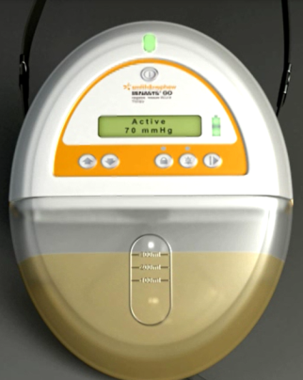
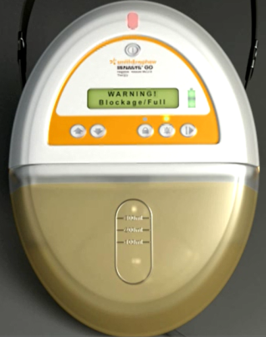
Canister selection and installation
RENASYS™ GO canisters use an integral two stage bacterial filter for protection of device against overflow and spread of aspirated micro-organisms
Canister kits are single use non sterile
Canisters are non-sterile and should not be used in a sterile field.
Always use the smallest canister volume possible. DO NOT use the 750mL canisters on patients with high risk of bleeding
Canisters should be changed at least once a week, whenever there is a change in patient or in the event that canister contents reach maximum volume indication (300mL or 750mL fill line)
Do not wait for the canister over-capacity alarm to activate to change canister.
Fluid has reached (300mL or 750mL) full line and the canister is ready to be changed
Canister is over full and level of fluid in the canister may affect the pressure level and exudate accumulation within the wound

Slide 22
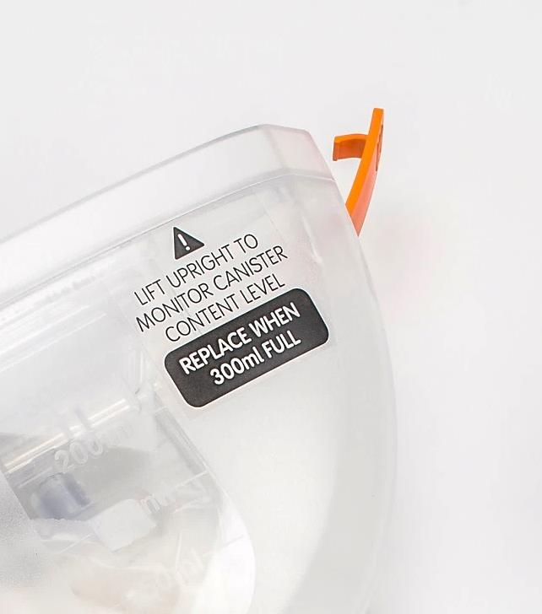
Canister selection and installation
Canisters may have to changed regularly within single-patient treatment episodes if exudate levels are high
Canisters should be changed at least once a week, whenever there is a change in patient or in the event that canister contents reach maximum volume indication (300mL or 750mL fill line).
Do not wait for the alarm activation to change canister
Check the canister for any signs of cracks or damage. If noted, discard and replace canister
Ensure the canister viewing window is checked frequently for signs of bleeding
For patients with high risk of bleeding, use 300mL canister
Canister kits are single use devices. Do not reuse
Notes:
Canisters should be changed at least once a week, whenever there is a change in patient or in the event the canister contents reach maximum volume indication (300mL or 750mL fill line). Do not wait for alarm activation to change canister. Canisters may have to be changed regularly within single-patient treatment episodes if exudate levels are high. Check canisters regularly to monitor exudate levels, ensuring they are below maximum volume indication (300mL or 750mL fill line). Check canister for any signs of cracks or damage. If noted, discard and replace canister. Ensure canister viewing window is checked frequently for signs of bleeding. For patients with high risk of bleeding, use 300ml canister.
Note: Change or replace canisters that have been dropped or mishandled even if no visible signs of damage are present to ensure correct operation of software alarms for leak and blockage.
(review slide bullet points)

Slide 23
Installing the canister
Ensure device is off
Remove paper tape around canister tubing to release tubing to full length
Open both orange clips on sides of canister
Align canister so that viewing window is facing forward
Push canister gently over device inlet port
Engage both canister clips. Clips will click when properly engaged
Following canister installation, to verify functional complete blockage alarm, turn device on and insert tethered cap of canister tubing into connector to simulate a blockage. A functional device will activate a complete blockage alarm within 5 minutes
In the case that complete blockage alarm does not activate, check canister installation and contact your Smith & Nephew authorized representative
Questions: Call 24/7 NPWT Clinical and Product Support Line 1-800-876-1261

Slide 24
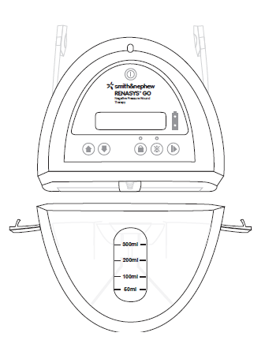
Removing or changing the canister
Hold orange quick click connector above wound to help ensure exudate does not leak from tubing
Turn device off
Disconnect canister tubing from Soft Port
Insert tethered cap into both sides of orange quick click connector
Release orange canister clips on sides of canister and gently pull away from device
Disposal of used canisters should follow facility protocols or local ordinances relating to handling of potentially infected or bio-hazardous material
Install new canister and verify functionality of complete blockage alarm
Securely connect opposite end of canister tubing to Soft Port and recommence therapy

Slide 25
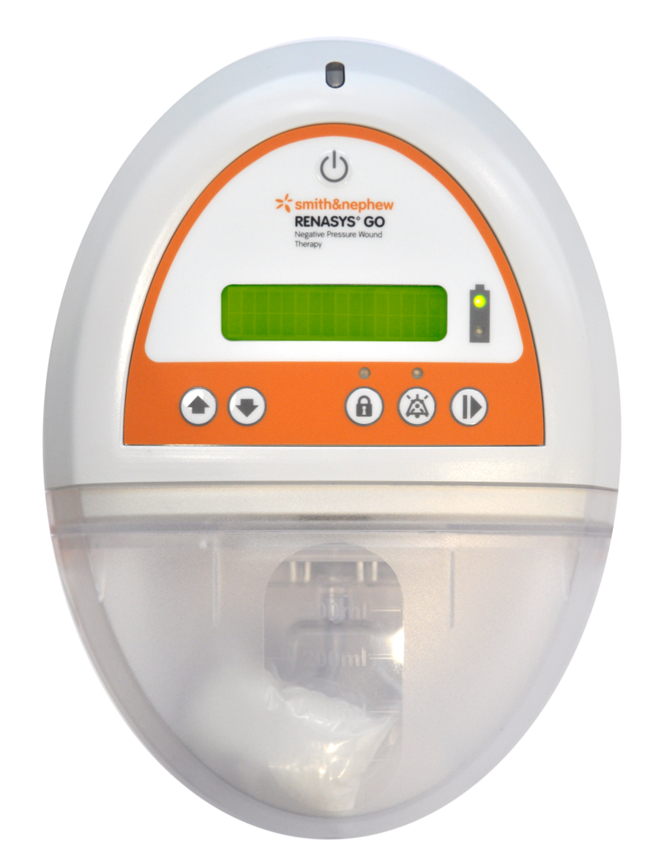
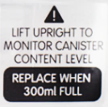
Status lights
Status LED:
Unlit = Standby
Green = Therapy
= Alarm condition
Yellow
Notes:
The status LED of the device has three levels of display
Unlit – the device is on standby
Green – the device is in therapy mode
Amber – the device has an alarm condition requiring investigation

Slide 26
Device start up
Device operates on both battery and electrical power
If battery operation is required for first use of device, battery must be charged from electrical power until battery status top indicator light illuminates solid green
During charging process the battery status top indicator light will flash green
If electrical power is required, connect power supply to the electrical power inlet, on the side of device
To activate device, press and hold Power button for 2 seconds. Device display will show:
If the device is being used for the first time, the user will be given the option to select the desired language

Slide 27
Language selection
To change language:
Turn device off
Simultaneously press and hold Up + Select + Power buttons for 2 seconds
Language can now be selected using Up and Down buttons to scroll to desired language, followed by Select button
Pressing Select button at this point will power on the device at a preset 80mmHg in continuous mode, if the device is being used for the first time, or the previously entered pressure setting

Slide 28
Starting therapy
Select the prescribed pressure setting using Up and Down buttons
Press Select button to start therapy
Finished dressing should be fully compressed, firm to the touch and leak free
Setting pressure level is a decision that the healthcare provider must make based on an individual assessment of the particular wound
40-120mmHg is the recommended therapeutic pressure range
In the event the wound is difficult to seal, the pressure setting may be increased to achieve the desired negative pressure at the wound bed
Device will show set pressure level. If device detects operation outside of the set pressure, it will result in alarm activation
Caution: Before starting therapy, ensure the device and system tubing are located no more than 19 inches (50cm) or higher than the wound and is away from any direct sources of heat

Slide 29
Pause/adjust therapy
Therapy may be paused by pressing Select button once
When paused, the device will show a standby message on display screen and pressure setting can be changed using the Up and Down buttons
Press Select button to restart therapy

Slide 30
Lock or unlock keypad
To lock the user interface when device is active, press and hold Keypad Lock button for 2 seconds
When activated, the light will illuminate solid blue
If the keypad on user interface has not been used for 15 minutes, key pad will automatically lock
In active mode, if keypad or user interface has not been used for 15 minutes, keypad will automatically lock
To unlock the user interface, press and hold the Keypad Lock button for 2 seconds
Note: Locking keypad only locks the row of keys under display screen. The Power Button is not locked

Slide 31
Home healthcare use (Lock)
The user interface may be locked for home healthcare use to prevent inadvertent changes to the therapy settings by unauthorized users in a homecare environment
To lock for homecare use:
Select prescribed therapy mode and pressure setting and start therapy
Note: Therapy must be started for homecare lock to function
Simultaneously press and hold the Keypad Lock + Audio Pause buttons for 5 seconds
The solid light above the keypad lock button will illuminate solid blue
When device is locked for homecare use, the therapy settings cannot be changed.
The Power and Audio Pause buttons are the only active buttons. The device may be powered off to temporarily stop therapy. When powered back on, the device will remain locked for homecare use and will resume therapy using the previously entered settings.
When device is locked for homecare use, screens displaying prescribed pressure setting will include 3 asterisks

Slide 32
Home healthcare use (Unlock)
To unlock the device from homecare use:
Simultaneously press and hold the Keypad Lock + Audio Pause buttons for 5 seconds
Note: When set for homecare use and powered on, the device will display one of the following depending on operating mode selected

Slide 33
Modes of operation
RENASYS™ GO offers both continuous and intermittent therapy modes
In continuous mode, device will maintain selected pressure setting without stopping until switched off
In intermittent mode, device cycles on and off in increments of 5 minutes “ON” (active vacuum) and 2 minutes “OFF” (no vacuum)
Intermittent therapy is not recommended for:
Highly exudating wounds
Wounds with tunnels or undermining
Wounds in difficult areas where maintaining a seal is problematic
Patients who experience pain during intermittent therapy

Slide 34
Modes of operation
To change therapy between continuous and intermittent mode:
Turn device off
Simultaneously press and hold Down + Select + Power buttons for 2 seconds
Use Up or Down buttons to scroll between continuous and intermittent mode. Press the Select button to confirm
Once therapy is started, display screen will show which mode of therapy has been selected

Slide 35
Clinician information screen
Device displays information which allows clinicians to see therapy time (total hours and minutes of continuous or intermittent therapy) delivered to the patient
To access therapy time:
Turn device off
Simultaneously press and hold Down + Select + Power buttons for 2 seconds.
Use Down button to scroll to "show time" option. Press Select to show the following display screen:
Therapy time display will show for 5 seconds and then return to main menu

Slide 36
Clinician information screen
To reset therapy time:
Use Down button to scroll to "clear time" option. Press Select button to show the following display screen:
Press Select button again to confirm that you want to clear active time
Use Down button to scroll to "yes" option. Press Select button to show the following display screen:
Display will show for 5 seconds and then return to main menu
Note: Active time should be cleared between patients. This will allow the clinician to monitor patient therapy compliance

Slide 37
Clinician information screen
Device displays total number of hours accumulated in active mode.
This time cannot be reset
To access total time display screen:
Turn device off
Simultaneously press and hold Down + Select + Power buttons for 2 seconds
Use Down button to scroll to "total time" option. Press select to show the following display screen:
Display will show for 5 seconds and then return to main menu

Slide 38
Clinician information screen – battery charge %
To access battery charge display screen:
Turn device off
Simultaneously press and hold Down + Select + Power buttons for 2 seconds
Use Down button to scroll to "battery charge" option. Press Select to show the following display screen:
Press Select button to return to the main menu

Slide 39
Battery power and status indication
A fully charged RENASYS™ GO battery can last up to 20 hours, dependent on pressure setting
During therapy, if battery level is low, the device can be plugged into electrical power without interrupting therapy. Battery will recharge while therapy continues to be delivered
There are several battery level status indicators on this device
Battery is fully charged and has up to 20 hours active therapy remaining. Battery status indicator will illuminate solid green
Display screen when device is locked for homecare use
Battery has up to 10 hours active therapy remaining. Battery status top indicator will flash green
Battery has up to 6 hours active therapy remaining. Battery status top indicator will flash green and battery status bottom indicator will illuminate solid yellow

Slide 40
Battery status indication
Plug device into electrical power to charge battery
Battery has up to 3 hours active therapy remaining. Battery status bottom indicator will illuminate solid yellow. Low battery alarm state
Battery has up to 1 hour active therapy remaining. Battery status bottom indicator will illuminate solid yellow. Low battery alarm state
Battery has only 2 minutes of active therapy remaining. Battery status bottom indicator will illuminate solid yellow. Low battery alarm state
After 2 minutes in an extremely low battery charge state, device will power off.

Slide 41
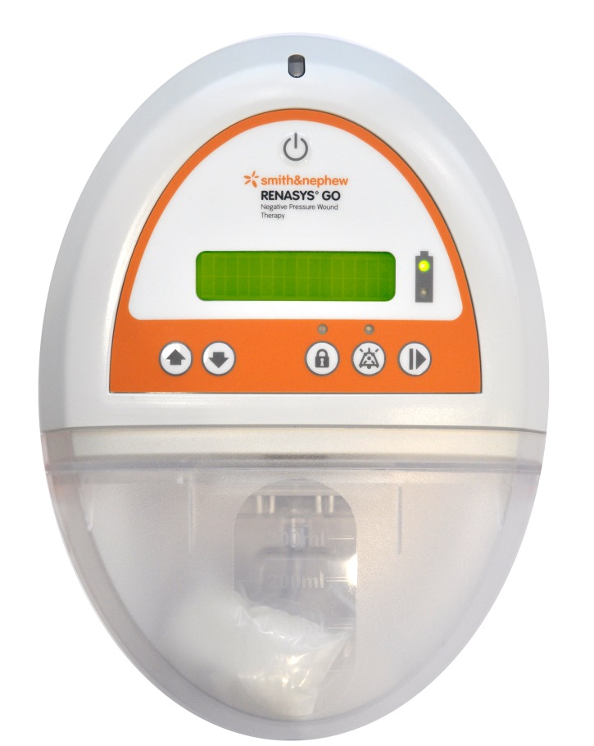
RENASYS™ GO device
Alarms
Cause and remedy

Slide 42
Over vacuum alarm
If the system encounters an excessively high vacuum of > 235 mmHg the device will stop delivering NPWT
Audible alarm will sound and indicator will illuminate
solid yellow

Slide 43
Cause and remedy
Alarm: Over vacuum alarm
Cause: Device has reached high vacuum levels (> 235mmHg)
Remedy:
Press and hold power button for 2 seconds to turn device off
Inspect connections and tubing to ensure they are free of obstructions. Ensure there are no kinks in canister tubing
Turn device ON by pressing and holding power button for 2 seconds
If alarm condition continues, device may have malfunctioned. Contact your Smith & Nephew authorized representative
Questions: Call 24/7 NPWT Clinical and Product Support Line 1-800-876-1261
43

Slide 44
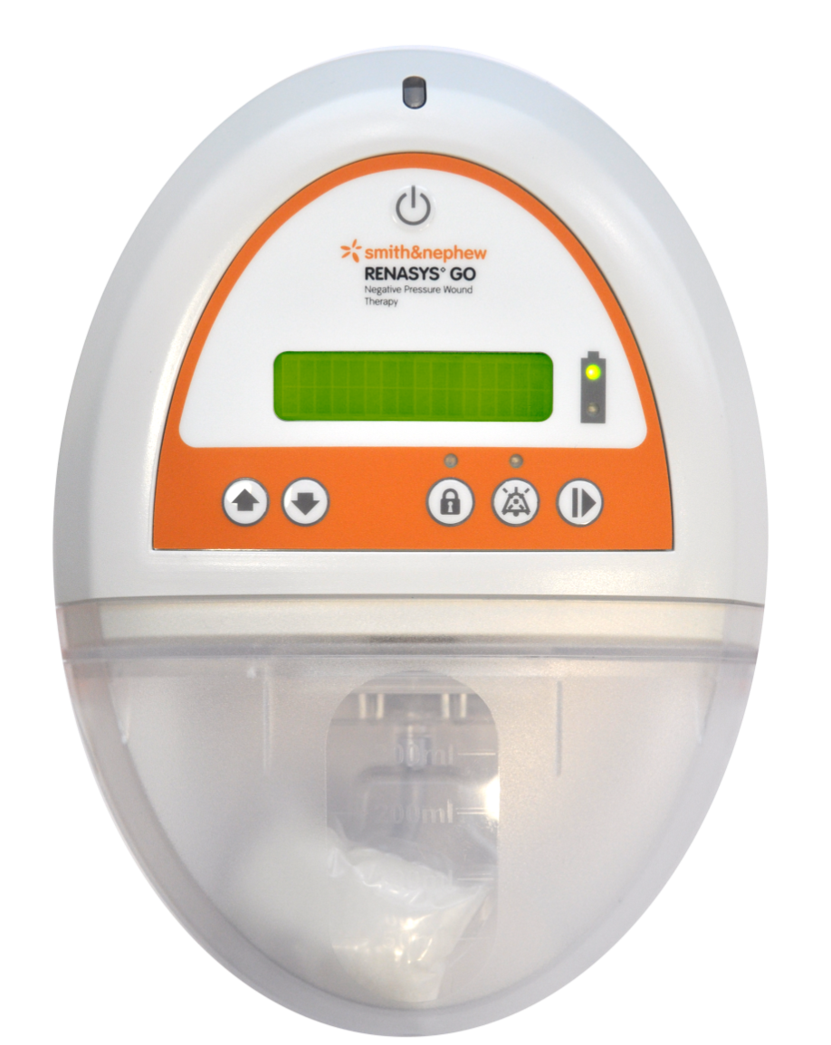
Leak alarm
Device detects a significant leak
Audible alarm will sound and indicator will illuminate
Pressing audio pause button will pause alarm for approximately 2–3 minutes
Once system is sealed, alarm(s) will automatically reset and status/alarm indicator will return to solid green
solid yellow

Slide 45
Cause and remedy
Alarm: Leak alarm
Cause: There is a significant leak in the system. This could include an air leak around the dressing or a poor seal at one of the connectors between the dressing, Soft Port, canister or device
Remedy:
With the device actively creating vacuum, check wound dressing for air leaks. Look for loose or decompressed dressing appearance, listen for air movement around dressing and feel for areas less compressed or cooler in temperature.
Address identified leaks with transparent film or RENASYS™ Adhesive Gel Patch
Ensure the following connections are secure:
Orange quick click connector between Soft Port and canister tubing
45

Slide 46
Cause and remedy
Alarm: Leak alarm (continued)
Remedy:
Disconnect Soft Port from canister tubing at orange quick click connector and insert tethered cap into both connectors
If alarm condition resolves, an air leak is present within the wound dressing or Soft Port. Reassess and replace as needed
If alarm condition continues, there is a potential issue with the device or canister
Replace canister
If alarm condition continues there is a potential issue with device, contact your Smith & Nephew authorized representative
Note: An air leak may result in a pressure drop occurring in the system. As a result, the low vacuum alarm may also activate while the leak alarm is active
Questions: Call 24/7 NPWT Clinical and Product Support Line 1-800-876-1261

Slide 47
Cause and remedy
Alarm: Leak alarm (continued)
Caution – Lack of alarms:
Under specific circumstances, a significant air leak may occur in system without device activating a leak alarm
This may be due to partial blockage between source of air leak and device, prohibiting detection of the leak by device. As a result, alarm will not activate
Over time, if blockage reaches point of full occlusion, the complete blockage/canister over-capacity alarm will activate
Read complete blockage/canister over-capacity alarm troubleshooting for instruction on locating the system blockage
Check wound dressing regularly to ensure it is fully compressed and firm to the touch

Slide 48
Low vacuum alarm
Vacuum level is lower than set point of NPWT by >15mmHg
Audible alarm will sound and indicator will illuminate
Pressing audio pause button will pause alarm for approximately 2–3 minutes
Once system is sealed, alarm(s) will automatically reset and status/alarm indicator will return to solid green
solid yellow
! WARNING
! LOW VACUUM
48

Slide 49
Cause and remedy
Alarm: Low vacuum alarm
Cause: Device is unable to achieve selected vacuum level due to an internal device malfunction or a significant leak in the system
Remedy:
With the device actively creating vacuum;
Check wound dressing for air leaks
Look for loose or decompressed dressing appearance, listen for air movement around dressing and feel for areas less compressed or cooler in temperature
Address identified leaks with transparent film or RENASYS™ Adhesive Gel Patch
Ensure the following connections are secure:
Orange quick click connector between Soft Port and canister tubing
Secure engagement of canister to device
49

Slide 50
Cause and remedy
Alarm: Low vacuum alarm (continued)
Remedy:
Disconnect Soft Port from canister tubing at orange quick click connector and insert tethered cap into both connectors
If alarm condition continues, there is a potential issue with the device or canister
Replace canister. If alarm condition continues contact your Smith & Nephew authorized representative
If alarm condition resolves, an air leak is present within the wound dressing or Soft Port. Reassess and replace as needed
Note: If low vacuum alarm is due to a leak in the system, the leak alarm may also activate while low vacuum is active
Note: If over vacuum indictor is illuminated along with low vacuum indicator, follow troubleshooting steps for over vacuum alarm
Questions: Call 24/7 NPWT Clinical and Product Support Line 1-800-876-1261
50

Slide 51
High vacuum alarm
Vacuum level is higher than set point of NPWT by >15mmHg and device will stop delivering therapy
Must be investigated by healthcare provider immediately
Audible alarm will sound and indicator will illuminate
solid yellow

Slide 52
Cause and remedy
Alarm: High vacuum alarm
Cause: Vacuum level is higher than NPWT set point by > 15mmHg
Remedy:
Press and hold power button for 2 seconds to turn device OFF
Inspect connections and tubing to ensure they are free of obstructions. Ensure there are no kinks in canister tubing
Replace canister
Turn device back ON by pressing and holding power button for 2 seconds. If alarm condition continues, device may have malfunctioned.
Contact your Smith & Nephew authorized representative
Questions: Call 24/7 NPWT Clinical and Product Support Line 1-800-876-1261
52

Slide 53
Complete blockage/canister over-capacity alarm
The device detects a complete blockage in the system, this includes a canister where contents have reached maximum volume capacity
There will be no negative pressure at the wound site
Audible alarm will sound and indicator will illuminate
Pressing audio pause button will pause alarm for approximately 2–3 minutes
Once corrected, the audible alarm and status/alarm indicator will return to solid green
solid yellow
53

Slide 54
Complete blockage/canister over-capacity alarm
Alarm: Complete blockage/canister over-capacity alarm
Cause: Complete blockage/canister over-capacity alarm activation is driven by occlusion of filter located at top of canister. As canister fills with fluid, the filter will begin to occlude as fluid makes continuous contact, creating a complete blockage in vacuum circuit. A completely occluded filter will result in canister over-capacity alarm activation
Complete blockage/canister over-capacity alarm will not activate until filter is completely occluded. Canister orientation, rate at which fluid enters canister and how exudate solidifies can impact filter occlusion and canister over-capacity alarm functionality
Remedy:
Canisters should be kept in an upright orientation to optimize canister over-capacity alarm functionality while maximizing canister volume. When canister is operating in horizontal orientation, facing upward, alarm functionality may be compromised
To optimize canister over-capacity alarm functionality, canister must be changed in the event the canister contents reach 2/3 full.
Do not wait for alarm activation to change the canister
54

Slide 55
Complete blockage/canister over-capacity alarm
Alarm: Complete blockage/canister over-capacity alarm
Cause: There is a complete blockage in the system; this includes a canister where contents have exceeded maximum volume capacity
Remedy:
Check canister. If contents have reached maximum volume indication (300ml or 750ml fill line) replace canister
Inspect connections, tubing and Soft Port aeration disc (located on Soft Port near the orange quick click connector) to ensure they are free of obstructions. Ensure there are no kinks in canister tubing
Disconnect Soft Port from canister tubing at orange quick click connector. Insert tethered cap into Soft Port connector. Allow air to flow freely into canister tubing
If alarm condition continues, there is a potential issue with the device or canister. Replace canister and contact your Smith & Nephew authorized representative
If alarm condition resolves, a blockage is present within the Soft Port. Reassess and replace as necessary
Questions: Call 24/7 NPWT Clinical and Product Support Line 1-800-876-1261
55

Slide 56
Complete blockage/canister over-capacity alarm
Caution – Lack of Alarms:
If partial blockage occurs, the change in pressure status detected by the device may not be significant enough to activate complete blockage/canister over-capacity alarm. Over time, if blockage reaches point of full occlusion, the complete blockage/canister over-capacity alarm will activate
Blockage formation within wound dressing will not be detected by the system as occlusion has formed outside the monitored vacuum circuit. However, it can impact pressure status at the wound site. Frequent monitoring of wound dressing is recommended to confirm adequate delivery of therapy
In the event of heavy or viscous drainage, drainage with sediment or when blood is present, regular monitoring and more frequent dressing changes may be required

Slide 57
Complete blockage/canister over-capacity alarm
Caution – Lack of Alarms (continued):
If a complete blockage is present in the system but an air leak occurs between the blockage and device, the complete blockage/canister over-capacity alarm may not activate
Ensure all connections are secure and no leaks are present in system. Potential sources of air leaks include:
Misplaced or worn O-ring on the device inlet port, located between the device and canister
Tear in Soft Port
Misplaced or worn O-ring within the orange quick click connector (between the Soft Port and canister tubing)
Cracked or damaged canister
Ensure that all dressing is fully compressed and firm to the touch

Slide 58
Inactive alarm
The system has been left in standby mode for more than 15 minutes
Audible alarm will sound every 20 seconds and indicator will illuminate
Note: The inactive alarm may only be audio paused once
solid yellow
58

Slide 59
Inactive alarm
Alarm: Inactive alarm
Cause: Device has been left in stand-by mode without any keys being pressed for longer than 15 minutes
Remedy:
Either select pressure setting and start therapy
or
Turn device OFF until therapy is required
59

Slide 60
Audio pause
If an alarm state is present the audible alarm may be paused for 2-3 minutes by pressing the audio pause button
Alarm states that can be audio paused include:
Inactive (can only be paused once)
Low vacuum
Complete blockage/canister over-capacity
Leak
Low Battery
Note: The above alarms can be paused indefinitely until device is turned off.

Slide 61
Audio pause
The following alarms cannot be audio paused (silenced):
Very low battery
Extremely low battery
High vacuum
Over vacuum

Slide 62
RENASYS™ GO device
Important information
Patient monitoring
Caution – lack of alarms

Slide 63
Patient monitoring
Carefully monitor the patient, device, and dressing frequently to determine if there are any signs of bleeding, exudate accumulation (pooling), infection, maceration, or loss of Negative Pressure Wound Therapy (NPWT)
The frequency should be determined by the clinician based on individual characteristics of the patient and wound. NPWT devices are not designed to detect or issue an alarm condition based on the presence of bleeding or pooling
These conditions may only be detected by frequent monitoring
NPWT may be impacted by various conditions related to system configuration, set-up and individual characteristics of the patient and wound (eg exudate characteristics, patient anatomy).
Alignment of the Soft Port to the opening in the drape, use of a bridging technique and choice of dressing configuration based on wound characteristics may impact NPWT vacuum delivery over the course of therapy
Note: Special attention to the risks of bleeding or loss of NPWT should be considered when prescribing NPWT for use in the community/home care setting

Slide 64
Patient monitoring continued
Exudate volume, viscosity and consistency may influence fluid removal or occlusion formation
A full canister, incorrect canister orientation and device/tubing height relative to the wound can contribute to loss of NPWT and exudate accumulation within the wound, which could lead to maceration, infection, or unrecognized bleeding
Monitor the wound for infection and ensure that all wound filler is removed at each dressing change to reduce the risk of infection
Skin grafts should be closely monitored to ensure NPWT is being delivered
Review Contraindications, Warnings and Precautions before use.
Notes:
Speaker notes/guidance:

Slide 65
Safety alarms
All alarms for RENASYS™ GO are determined to be "Low Priority," indicating that operator awareness is required (IEC 60601-1:2005, 3rd edition and IEC 60601-1-8:2006)
In an alarm state with the audio paused, if a different alarm state occurs, the audio pause will be cancelled, the audio will sound and the display screen will indicate the new alarm state
When multiple alarm states are present, the device's display screen will alternate between the display information for each alarm activated
Cautions – Lack of alarms:
Under specific circumstances, a significant air leak may occur in system without device activating a high flow/leak alarm. This may be due to partial blockage between source of air leak and device, prohibiting detection of the leak by device. As a result, alarm will not activate.
Over time, if blockage reaches point of full occlusion, the complete blockage alarm will activate. Read complete blockage/canister over-capacity alarm troubleshooting for instruction on locating the system blockage. Check wound dressing regularly to ensure it is fully compressed and firm to the touch.

Slide 66
RENASYS™ GO – zone of detection
Zone of detection
Notes:
The zone of blockage detection is from the Soft Port inlet hole to the top of the canister

Slide 67
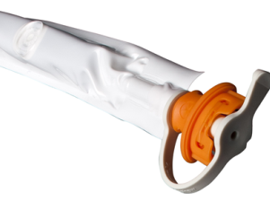
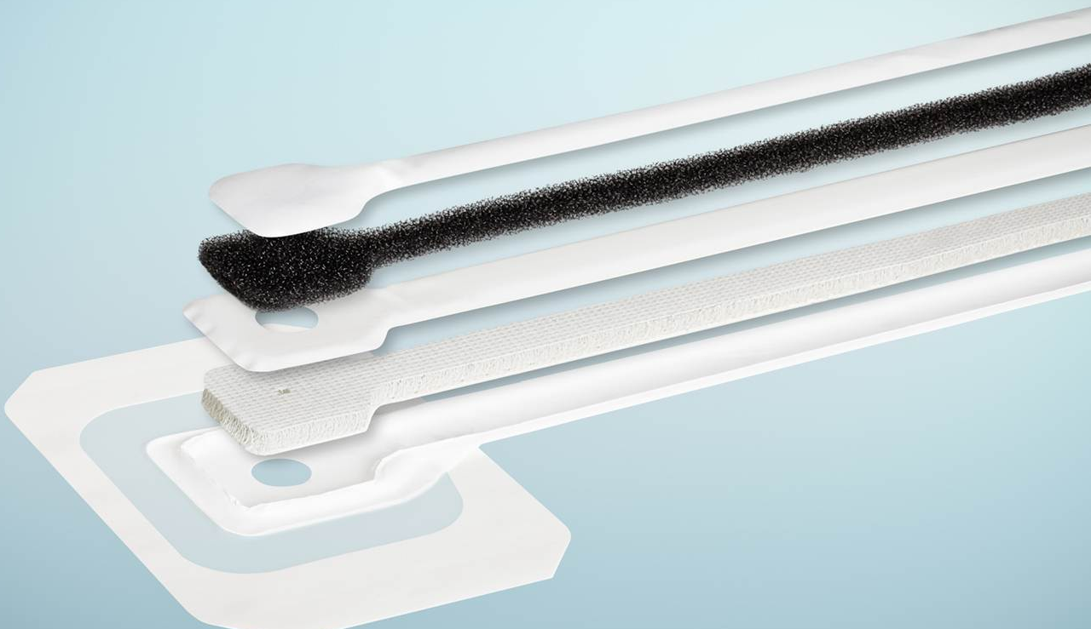
RENASYS™– Controlled Leak Path (CLP)
Aeration disc
Aeration layer: top layer of RENASYS Soft Port
Polyurethane foam material
Passage way for controlled amount of air flow entering through the aeration disc
Controlled air leak path – 0.08 – 0.16 lpm at 80mmHg
Exudate removed from wound
Fluid handling layer: bottom layer of RENASYS Soft Port
3D lattice material
Passage way for exudate removed from wound combined with controlled amount of air flow
Notes:
This diagraham shows the composition of the Soft Port and the function of the controlled leak path. (Detail features and function described on slide)

Slide 68
Leak alarm caution
68

Slide 69
RENASYS™ leak alarm
In the RENASYS system an increase in air flow triggers a leak alarm. The air flow must rise above a specific level for the leak alarm to be triggered
Under normal circumstances an air leak at the dressing is seen at the device and the leak alarm is triggered
2. The higher air flow reaches the device and triggers a leak alarm
1. Air leak
introduces air into the system
Notes:
With the new subject of Leak alarm, lets start with a simple explanation of how the Leak alarm works.
The Leak alarm is triggered when the RENASYS device detects a high flow of air above a threshold level.
In the diagram the large arrows represent the air entering the system from the air leak. In this case the air leak is at the wound dressing. It could be in any location within the system, although an air leak at the dressing is probably the most common example.
The air flow required to triggered the Leak alarm is many times greater than the air flow from the Soft Port aeration disc shown in the diagram as the small arrows.

Slide 70
Caution – lack of leak alarm
Under specific circumstances, a significant air leak may occur in the system without the device activating a leak alarm
This may be due to partial blockage between the source of the air leak and the device, prohibiting detection of the leak by the device, resulting in no alarm activation
3. Air flow to the device is in the normal range and the Leak alarm is not triggered
If a partial blockage is present, this can prevent the normal air flow from the air leak reaching the pump. In this case the leak alarm will not be triggered
2. Partial Blockage reduces the air flow to the device
1. Air leak
Notes:
The caution in the new Instructions for Use regarding the Leak alarm is related to the presence of a partial Blockage.
In the diagram we have an air leak at the wound dressing. We also have a partial blockage in the canister tubing. The air from the air leak can only reach as far as the partial blockage, as the restriction of the partial blockage limits the amount air flowing past it. In this case the amount of air that does flow past is less than that needed to trigger the Leak alarm. So there is no leak alarm even though it may be possible to observe the drape lifted from the patients skin, and an absence of negative pressure at the wound.

Slide 71
Caution – lack of leak alarm (continued)
Potential sources of partial blockage include:
Physical occlusion in wound dressing (coagulated blood or purulent material in filler, compacted filler, high volume viscous fluid)
Physical occlusion in the tubing (kink in the canister tubing, clot in the tubing)
Soft Port aperture misaligned to dressing opening
Check wound dressing regularly to ensure that it is fully compressed and firm to the touch
Partial blockage
Air leak
Notes:
The partial blockage could occur in other places than the one shown in the diagram.
It could be in the wound filler material due to coagulated blood, compacted gauze filler and / or high volume viscous fluid.
It could also be Soft Port misalignment with the hole in the transparent film.
And this relates back to the importance of monitoring the patient and the dressing to ensure that negative pressure is visibly evident at the wound. The dressing should be fully compressed, and the transparent film should be sucked down against the skin and wound filler.

Slide 72
Blockage alarm caution
72

Slide 73
RENASYS™ blockage alarm
The RENASYS system blockage alarm utilizes the natural air flow from the Soft Port aeration disc as an expected background air flow. While this air flow is present there is no blockage alarm
2. Air flow through the device is normal. There is no blockage
1. Aeration disc provides a background air flow
73
Notes:
I would first like to explain as simply as possible how the blockage alarm works. This diagram shows RENASYS GO. The same explanation applies to RENASYS EZ MAX.
The orange arrows represent air being drawn into the system by the negative pressure. The air is entering via the aeration disc in the Soft Port. This air flow is the basis of the blockage alarm mechanism. An air flow of this type is recognised by the pump as normal operating conditions and there are no alarms, neither Blockage nor air Leakage.

Slide 74
RENASYS™ blockage alarm
A blockage in the RENASYS system prevents the air flow from the aeration disc reaching the device. The device detects the lower air flow and this triggers a blockage alarm
2. No air flow through the device triggers the blockage alarm
1. Blockage
e.g. in canister tubing prevents the air flow from the aeration disc progressing towards the device
74
Notes:
Contrast those normal conditions with the situation in which there is a blockage in the canister tubing.
Now the air from the aeration disc can enter the system but is unable to progress any further than the blockage in the canister tubing. Air flow to the RENASYS GO device has been prevented, and the RENASYS GO device recognises this as a blockage, and the Blockage alarm is triggered.
In this diagram the blockage is shown in the canister tubing. The blockage could be in any position between the RENASYS GO device and the head of the Soft Port. This is the Zone of Blockage detection mentioned in earlier slides.

Slide 75
Caution – lack of blockage alarm
If a blockage develops gradually, during the stage at which there is only a partial blockage, (rather than a complete blockage), there may not be a blockage alarm. This is because the air flow to the device is above the blockage alarm trigger point
2. The air flow reaching the device prohibits the device detecting the blockage
1. Partial blockage
eg in canister tubing reduces the air flow towards the pump but does not eliminate it
75
Notes:
There are 3 situations in which it is important to recognise that a Blockage alarm would not be expected.
The first is if the blockage is partial, which means that some air is able to pass the blockage, i.e. it is not a complete blockage. A partial blockage is best described as a substantial restriction in the flow of air and fluid compared with normal operation.
This diagram shows a reduced amount of air from the Soft Port aeration disc passing by the partial blockage. It is still enough air for the RENASYS GO device to interpret this as normal conditions. There is no blockage alarm.
Partial blockages can impact the level of negative pressure at the wound if the dressing seal is lost.

Slide 76
Caution – lack of blockage alarm (continued)
Negative Pressure Wound Therapy devices are unable to detect a blockage that has formed within the wound dressing as the blockage has occurred outside of the monitored vacuum circuit.
Nevertheless a blockage within the wound dressing can affect pressure (vacuum) status at the wound
Regular monitoring of the wound dressing and more frequent dressing changes may be required in the event of:
Heavy or viscous drainage
Drainage with sediment
Presence of blood
3. Normal air flow through the device, and therefore no blockage alarm
Wound
1. Blockage within the foam or gauze dressing
2. Air flow from the Soft Port aeration disc is uninterrupted and reaches the device
Notes:
This next situation is very similar to the Bridging examples I explained earlier. While there is no bridging, there is blockage in the wound filler which was one of the scenarios discussed under bridging. The blockage is outside the zone of blockage detection.
Blockage in wound fillers can occur with heavy or viscous exudation, exudate with sediment or with the presence of blood, due to the possibility of clotting. And as we saw earlier, the foam wound filler is more able to cope with heavy and viscous exudate than the gauze wound filler.
The air flow through the Soft Port aeration disc to the RENASYS GO device is normal and therefore the Blockage alarm will not be triggered.

Slide 77
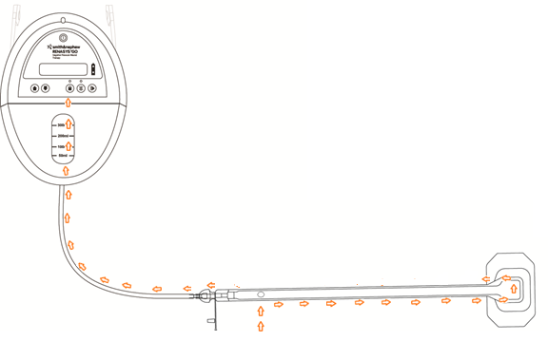
Caution – lack of blockage alarm (continued)
If a complete blockage is present in the system, but an air leak occurs between the blockage and the device, the alarm may not activate
Ensure all connections are secure and no air leaks are present in the system
Potential sources of air leaks include:
Misplaced or worn O-ring between device and canister
Tear in Soft Port
Misplaced or worn O-ring in connector between Soft Port and canister tubing
Cracked or damaged canister
6. Air flow through the device is within the normal range and the blockage is not detected
4. Minor Air leak
(in this example shown at the connector)
3. No air flow back to canister within the Soft Port
1. Blockage
5. Air flow (introduced in this example by the leaking connector) recreates an air flow similar to the aeration disc air flow
2. Air flow from the aeration disc is stopped by the blockage
Notes:
The final situation to mention regarding the Blockage alarm is the case in which there is an unintentional minor air leak in the system between the blockage and the RENASYS device.
In this diagram a blockage is present in the Soft Port. The air flow from the Soft Port aeration disc can go no further than the blockage. This absence of air flow would normally trigger a Blockage alarm, however in this case there is another source of air flow. In this diagram it is a minor air leak at the connector. This minor air leak is mimicking the normal air flow from the Soft Port aeration disc and the RENASYS device does not detect the blockage.
Ensuring connections are secure is therefore important for correct alarm function. And, in the red text, there is a list of the potential sources of minor air leaks.
It is also important to realise that if any of these leaks are larger than ‘minor’ they will trigger a Leak alarm.

Slide 78
Bridging caution and considerations
78

Slide 79
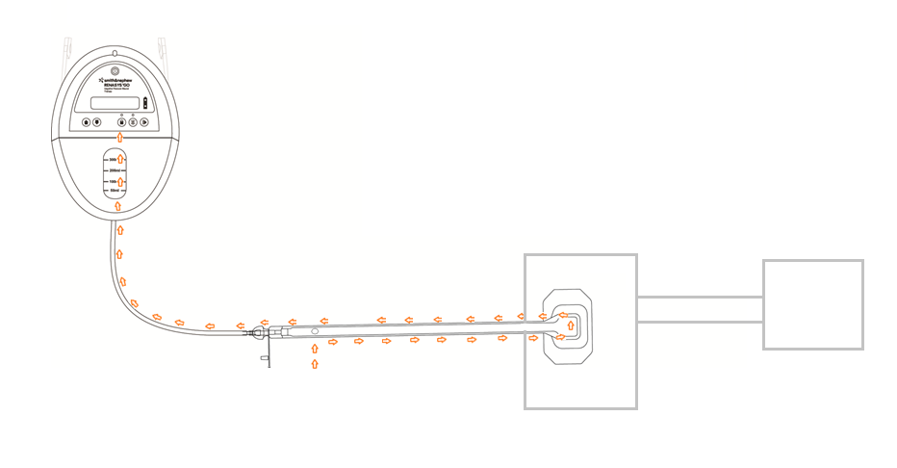
Bridging technique
Bridging wounds together expands the communication of pressure through the system, which is inherently more demanding
If a blockage exists within the bridge or dressing, an air leak will not reach the Soft Port where it can be detected. This behavior is seen with all NPWT systems
When using the bridging technique it is recommended that the whole system is monitored more frequently, checking for visual confirmation that all wounds are under vacuum
Air Leak may not be detectable here if there is a blockage or restriction in the bridge
Wound 1
Wound 2
Bridge
A blockage or a restriction in either the ‘Bridge’ or the wound filler of either wound is not detectable
Zone in which blockage can be detected
Notes:
The next topic is Bridging. This diagram shows 2 wounds bridged together being managed by a single RENASYS GO. The same information applies to RENASYS EZ MAX.
The first thing to notice is that I have identified the zone in which blockage can be detected. That zone extends from the device to the end of the Soft Port. It does not include either of the wounds nor the bridge between the wounds. There is more explanation of how the blockage alarm works later in the presentation so this will become more understandable shortly.
If a blockage does exist in either wound filler or the bridge between the wounds, there will not be a blockage alarm. The blockage is outside the zone in which a blockage can be detected.
This is not unique to RENASYS, it is common to NPWT systems generally.
If such a blockage exists then any subsequent air leak distal of the blockage will not be seen by the pump either. This is one explanation of the presence of a lifted transparent film without a Leak alarm.
The bridging of wounds together is being highlighted here because it usually represents a more challenging set of circumstances for the transmission of negative pressure. Alternative to bridging is to use two pumps.

Slide 80
Bridging technique
Bridging away from a wound is unlikely to be necessary when using the RENASYS™ Soft Port, nevertheless if this technique is employed it is recommended that the whole system is monitored more frequently
Particularly checking visually that the wound is under vacuum
An air leak may not be detectable here if there is a blockage or restriction in the bridge or wound filler
Bridge
Wound
Zone in which blockage can be detected
A blockage or a restriction in either the ‘Bridge’ or the wound filler is not detectable
Notes:
The second example of bridging is bridging away from a wound to minimize pressure damage to the patient’s skin. This is unlikely to be necessary with the Soft Port, but some customers may still want to do this, hence the explanation here.
As in the previous slide the blockages in the bridge and wound filler lie outside the zone in which the blockage can be detected.
If such a blockage is present any lifting of the transparent film at the wound which allows an air leak will not be detected by the pump, as the air leak is not connected to the pump in the same way that it would be if the bridge and wound filler were unrestricted.
Blockages in these regions will cause loss of vacuum at the wound that cannot be detected by the RENASYS device.

Slide 81
RENASYS™ GO device
Accessories

Slide 82
RENASYS™ GO carry straps
To attach carry strap to device:
Feed end of open strap behind location pin on side of device
Pull strap through and feed the end behind clip on carry strap
Close clip to secure strap
Repeat steps 1-3 on other side of device
Once both sides of the carry straps are connected to device, they can be joined together to make the short carry strap
The short carry strap can be used to attach the device to a wheelchair or IV pole when moving patients
Note: Device carry bag and strap are designed to be a single patient use item

Slide 83
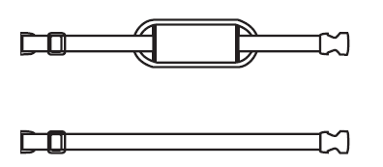
RENASYS™ GO shoulder and extension straps
The carry strap can be extended to allow the device to be carried on the shoulder or across the body
Place the padded section of the shoulder strap against shoulder for maximum comfort when carrying device
Note: Device carry bag and strap are designed to be a single patient use item

Slide 84
RENASYS™ GO carry bag (300mL canister only)
To place device into the carry bag:
Open zipper on both sides of bag and place face down on a flat surface with viewing flaps on top
Place device face up on the open bottom section of the bag
Pull front of the bag over top of the device and feed both parts of one zipper together
Close zipper on the other side of the bag
Once fitted ensure canister tubing can move freely
Excess tubing can be coiled and placed in the pouch on the back of the carry bag
Note: Device carry bag and strap are designed to be a single patient use item

Slide 85
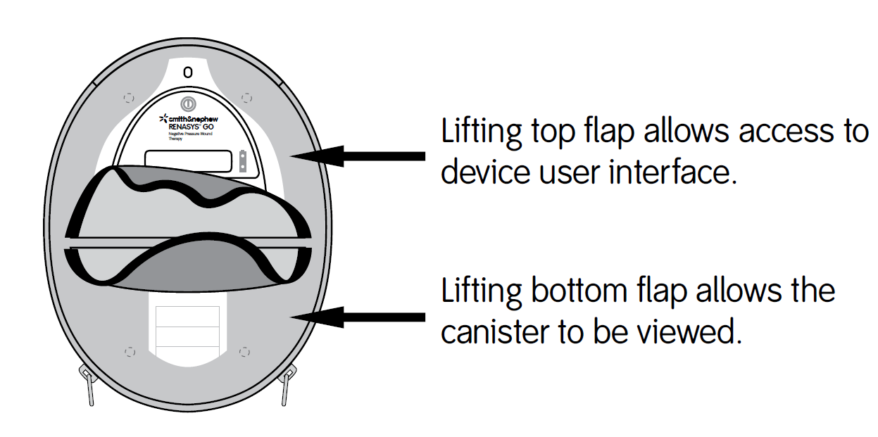
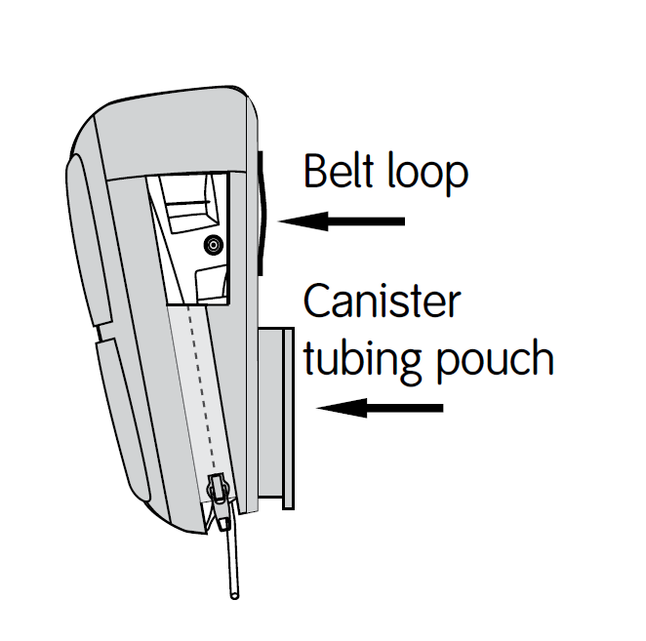
RENASYS™ GO carry bag (300mL canister only)
Flaps on the front of the bag provide privacy and discretion for the user
On rear of the bag, there is a belt loop, to allow users to wear RENASYS™ GO around their waist
Device and canister should remain in an upright orientation to maximize canister volume and optimize complete blockage/canister over-capacity alarm
Note: Device carry bag and strap are designed to be a single patient use item

Slide 86
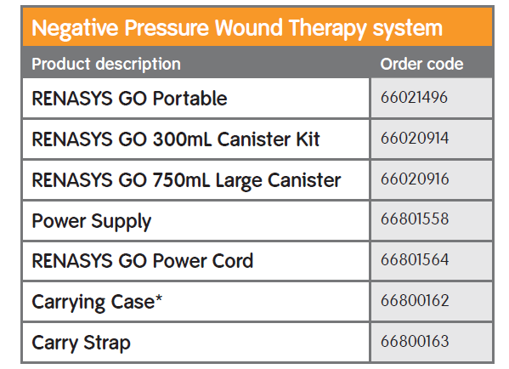
RENASYS™ GO ordering information
*Carrying Case is only compatible with the 300mL Canister

Slide 87
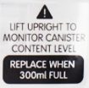
Questions
For detailed product information, including indications for use, contraindications, precautions and warnings, please consult the product’s Instructions for Use (IFU) prior to use.
©2016 Smith & Nephew, Inc. All rights reserved.
™Trademark of Smith & Nephew.
RNPE-33-0716-UE

